Slide 1

JSON in Python

Slide 2
JSON
JSON stands for JavaScript Object Notation & it is originated from javascript
standard for data interchange.
It means that a script (executable) file which is made of text in a programming language, is used to store and transfer the data.
Python supports JSON through a built-in package called JSON.
JSON Syntax
{
  “greeting”: “Good Afternoon”
}

Slide 3
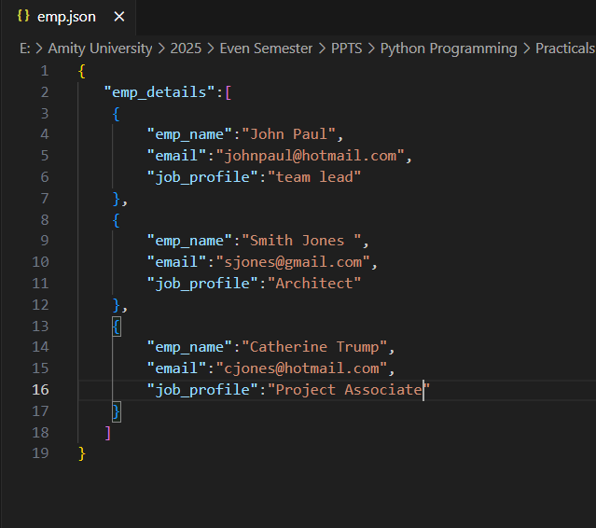

Slide 4
JSON Syntax
Inside the JSON object, you can define zero, one, or more key-value pairs. If you add multiple key-value pairs, then you must separate them with a comma (,).
A key-value pair in a JSON object is separated by a colon (:).
On the left side of the colon, you define a key. A key is a string you must wrap in double quotes ("). Unlike Python, JSON strings don’t support single quotes (').

Slide 5
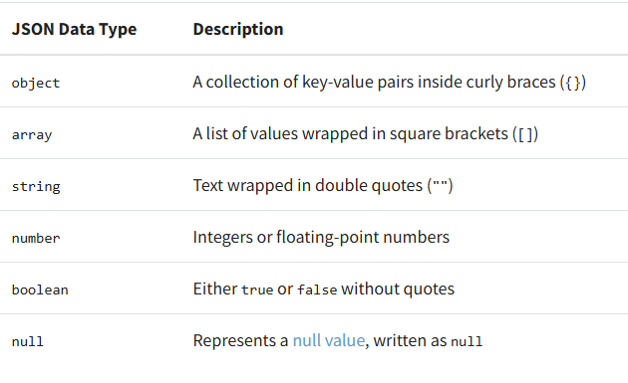
JSON datatypes

Slide 6
Python with JSON
Python supports the JSON format through the built-in module named json.
The json module is specifically designed for reading and writing strings formatted as JSON.
The act of converting data into the JSON format is referred to as serialization.
This process involves transforming data into a series of bytes for storage or transmission over a network.
The opposite process, deserialization, involves decoding data from the JSON format back into a usable form within Python.

Slide 7
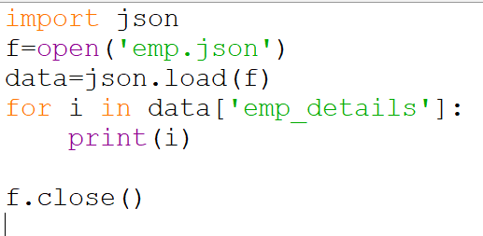
Reading a file in JSON

Slide 8
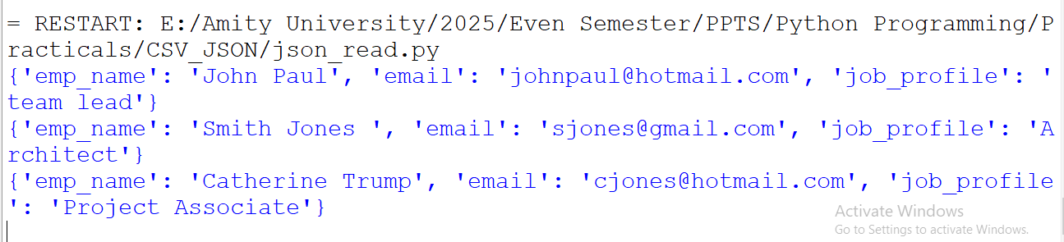
Output

Slide 9
json
In parallel to json.dumps() and json.dump(), the json library provides two functions to deserialize JSON data into a Python object:
  json.loads(): To deserialize a string, bytes, or byte array instances
  json.load(): To deserialize a text file or a binary file

Slide 10
Deserialize a JSON String to an Object in Python
The Deserialization of JSON means the conversion of JSON objects into their respective Python objects.
The load()/loads() method is used for it. If you have used JSON data from another program or obtained it as a string format of JSON, then it can easily be deserialized with load()/loads(), which is usually used to load from string, otherwise, the root object is in list or dict.

Slide 11
The End

